Slide 1

Capstone project: Telecom Customer Churn
by Prakul Garg

Slide 2
Agenda
Problem Statement
Objective & KPIs
Data Visualization & EDA
Feature Engineering
Assess multiple algorithms
Hyperparameter tuning
Performance
Summary

Slide 3
Problem Statement
Due to increasing churn rate of customers from last several quarters, the company has decided to dive deep into factors driving it. Past efforts in retaining customers have been reactive where the suggested steps were applied at the point of no return. The idea is to use machine learning to predict the likelihood of churn for each customer and reasons behind it. These reasons could be different for each customer. This will help with targeted response tailored to customer’s preferences thereby helping them stay and improving customer loyalty.

Slide 4
Objective & KPI
The idea is to build a model to predict how likely a customer will churn by analyzing its characteristics:
Demographic information
Account information
Services information
Key Performance Indicator
Confusion matrix
Evaluation Metrics
Accuracy
Sensitivity
Specificity
Precision
The objective is to obtain a data-driven solution that will allow us to reduce churn rates and, consequently, to increase customer satisfaction and corporation revenue.

Slide 5
Implementation
Exploratory Data Analysis
Data Visualization
Feature Engineering
Assess Multiple Algorithms
Performance
Conclusion
Hyperparameter tuning

Slide 6
Data Set
The dataset “Telco_Customer_Churn.csv” contains 19 independent variables
Demographic Information
Gender (M, F)
Customer Account information
Tenure: # of months (Numeric value)
Service Information
Phone Service (Yes, No)
Multiple Lines (No Phone, Yes, No)
Senior citizen (0,1)
Partner (Yes, No)
Dependents(Yes, No)
Payment Method (Electronic check, Mailed check, Bank transfer (automatic), Credit Card (automatic))
Contract (Month-to-month, One Year, Two Year)
Paperless Billing (Yes, No)
Monthly Charges: Amount (Numeric Value)
Total Charges: Amount (Numeric Value)
Internet Services (DSL, Fiber optic, No)
Online Security: (No internet service, No, Yes)
Online Backup (No internet service, No, Yes)
Device Protection (No internet service, No, Yes)
Tech Support (No internet service, No, Yes)
Streaming TV (No internet service, No, Yes)
Streaming Movies (No internet service, No, Yes)

Slide 7
Data cleaning
Check for missing values/ null values in the data for all the features
Fill the missing value for numerical columns with mean/ median (whichever looks more appropriate as per the feature)
Fill the missing value for categorical column with new value (e.g. “missing value”)
Identify and remove the data that looks incorrect/ contradictory
Check if the data type is correct for each feature, otherwise typecast it to correct type
e.g. “Total Charges” was converted from object type to numerical type
Identify and remove the features that looks irrelevant to predict the churn
e.g. Customer Id column was dropped

Slide 8
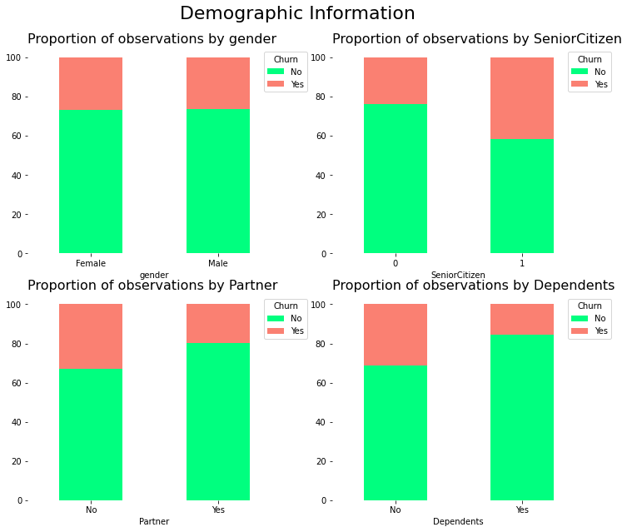
Data Visualization
Visualize the churn with respect to different Demographic features

Slide 9
Demographic Information - Inference
We can extract the following conclusions by analyzing demographic attributes:
The churn rate of senior citizens is almost double that of young citizens.
We do not expect gender to have significant predictive power. A similar percentage of churn is shown both when a customer is a man or a woman.
Customers with a partner churn less than customers with no partner.
Customers with a dependent churn less than customers with no dependents

Slide 10
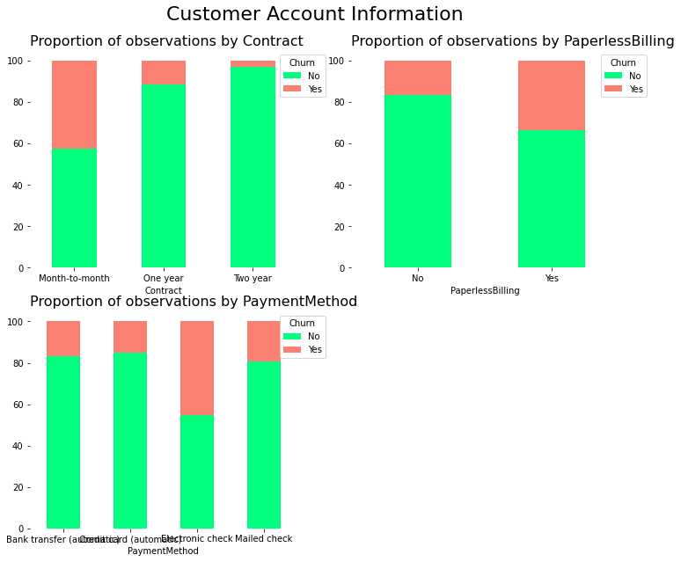
Customer Account Information – Categorical Variables

Slide 11
Customer Account Information - Inference
We can extract the following conclusions by analyzing customer account attributes:
Customers with month-to-month contracts have higher churn rates compared to clients with yearly contracts
Customers who opted for an electronic check as paying method are more likely to leave the company
Customers subscribed to paperless billing churn more than those who are not subscribed

Slide 12
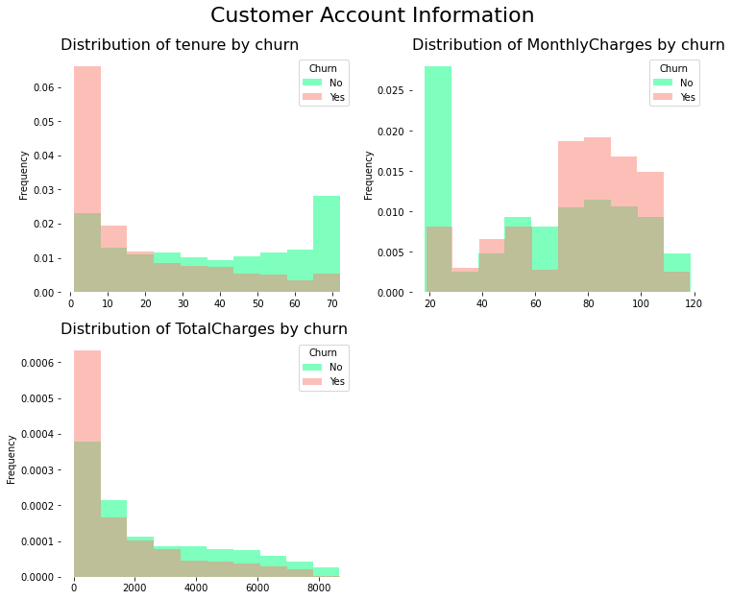
Customer Account Information – Numerical Variables

Slide 13
Customer Account Information - Inference
We can extract the following conclusions by analyzing the histograms:
The churn rate tends to be larger when monthly charges are high.
New customers (low tenure) are more likely to churn.
Clients with high total charges are less likely to leave the company.

Slide 14
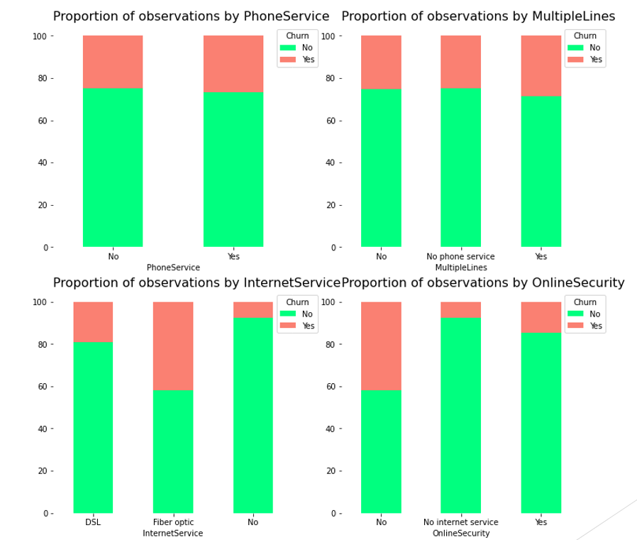
Service Information

Slide 15
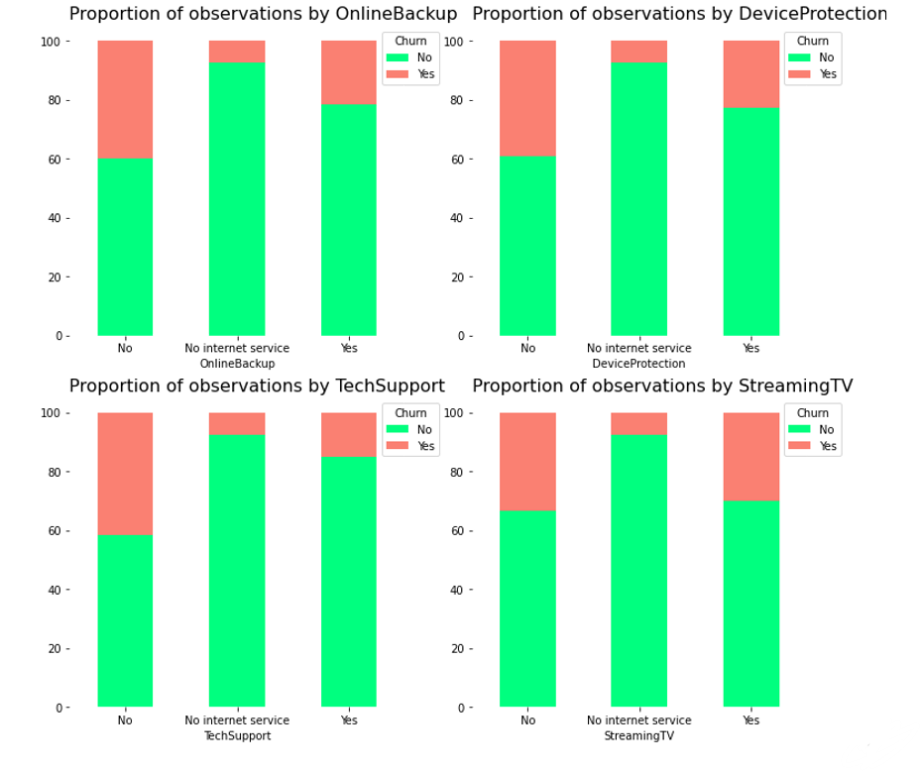
Service Information

Slide 16
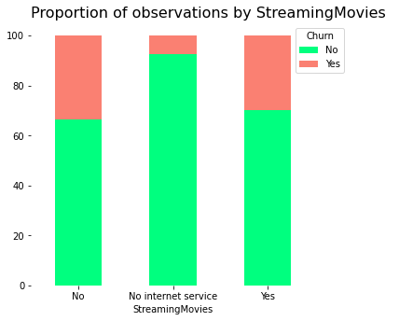
Service Information

Slide 17
Service Information - Inference
We can extract the following conclusions by evaluating services attributes:
We do not expect phone attributes (PhoneService and MultipleLines) to have significant predictive power. The percentage of churn for all classes in both independent variables is nearly the same
Clients with online security churn less than those without it
Customers with no tech support tend to churn more often than those with tech support

Slide 18
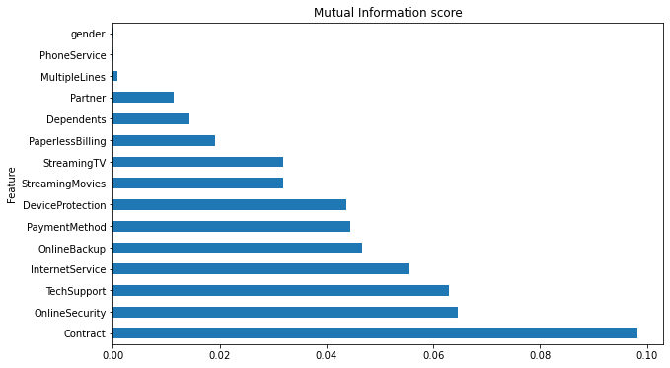
Feature Importance
Mutual information between each feature (independent variable) and churn (dependent variable)
Gender, Phone Service, and Multiple Lines have a mutual information score close to 0.
These columns are dropped from the dataset as they do not have strong relationship with the churn.

Slide 19
Feature Engineering
Our data set has both numerical and categorical columns, since we cannot apply mathematical functions on categorical data, therefore we convert categorical columns to numerical columns.
Label Encoding is done on the columns that have text data such as “yes” or “no”, or “Male”, or Female”, etc. It is converted to binary data such as 0 or 1.
Label encoding is done on following features:
Partner
Dependents
PaperlessBilling
PhoneService
Churn
One-Hot Encoding creates a new binary column for each level of the categorical variable. The new column contains zeros and ones indicating the absence or presence of the category in the data.
One-Hot Encoding is done on following features:
Contract
PaymentMethod
MultipleLines
InternetServices
OnlineSecurity
OnlineBackup
DeviceProtection
TechSupport
StreamingTV
StreamingMovies

Slide 20
Normalization
Data Normalization is a common practice in machine learning which consists of transforming numeric columns to a common scale. The features with higher values will dominate the learning process; however, it does not mean those variables are more important to predict the target. Data normalization transforms multiscaled data to the same scale. After normalization, all variables have a similar influence on the model, improving the stability and performance of the learning algorithm.
The min-max approach (often called normalization) rescales the feature to a fixed range of [0,1] by subtracting the minimum value of the feature and then dividing by the range.
Min-Max normalization is applied on following features:
Tenure
Monthly Charges
Total Charges

Slide 21
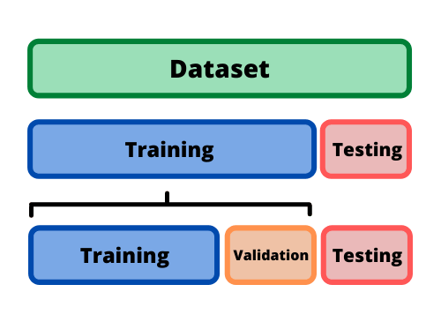
Model Selection, Training, Prediction and Assessment
Before building the model, the dataset is split into Training and testing sets.
75%
25%
Evaluate different models and measure the performance
Dummy Classifier, Accuracy: 0.745164960182025
K Nearest Neighbors, Accuracy: 0.7531285551763367
Logistic Regression, Accuracy: 0.7923777019340159
Support Vector Machines, Accuracy: 0.7878270762229806
Random Forest, Accuracy: 0.7713310580204779
Gradient Boosting, Accuracy: 0.7963594994311718 (Highest accuracy)

Slide 22
Hyperparameter Tuning
To address a potential bias stemming from the specific split of the data in the train-test-split part, cross-validation is used during hyperparameter tuning with Randomized Search
The best hyperparameters are:
N estimators: 80
Min samples split: 2
Max features: log2
Max depth: 3
Hyperparameter tuning with cross validation (K=5)

Slide 23
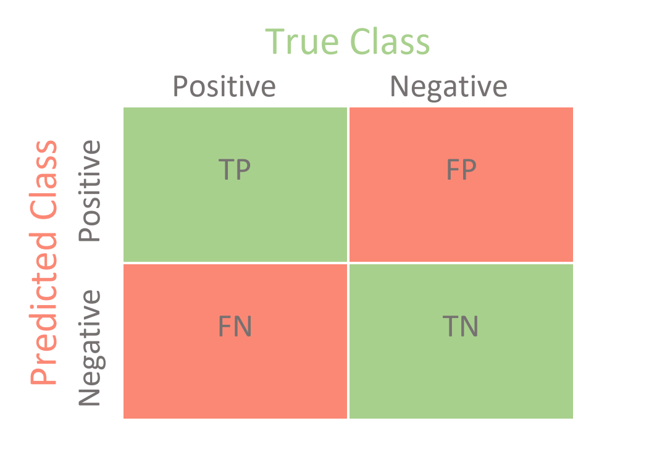
Performance
Evaluate the performance of the Gradient boosting classifier with best hyperparameters
Confusion matrix
The confusion matrix, also known as the error matrix, is used to evaluate the performance of a machine learning model by examining the number of observations that are correctly and incorrectly classified.
True Class
Positive
Negative
Positive
1155 | 155
200 | 248
Predicted Class
Negative
Accuracy: 0.798
It represents the proportion of predictions that were correctly classified.
Observation
Hyperparameter tuning has barely increased the accuracy of the model

Slide 24
Evaluation Metrics
Evaluate the quality of the model based on the elements of the confusion matrix
Metric | Formula | Value
Accuracy: It represents the proportion of predictions that were correctly classified | TP + TN TP + TN + FP + FN | 0.798
Sensitivity: It represents True Positive Rate, it refers to the probability of a positive test, conditioned on truly being positive | TP TP + FN | 0.852
Specificity: It represents True Negative Rate, it refers to the probability of a negative test, conditioned on truly being negative | TN TN + FP | 0.615
Precision: It represents the proportion of positive predictions that are actually correct | TP TP + FP | 0.881
Since the original data set was imbalance, as 75% of data is users that have not churned, and only 25% of data is of churned users. The same is reflected in the accuracy of the model, as Sensitivity (True Positive rate) is higher than Specificity (True Negative rate).

Slide 25
Summary
Original data set was imbalance towards non-churned users (75% non-churned users, and 25% churned users)
Customers with month-to-month contracts have higher churn rates compared to clients with yearly contracts
Customers with a partner churn less than customers with no partner
Payment method electronic check shows much higher churn rate than other payment methods
Clients with online security churn less than those without it.
Customers with no tech support tend to churn more often than those with tech support
Churn rate of senior citizens is very high
Gender, Phone Service, and multiple lines have no impact on churn rate
The best accuracy on the test set is achieved by the Gradient Boosting algorithm with accuracy 0.798
Hyperparameter tuning has barely increased the accuracy of the model
Sensitivity (True Positive rate) of the model is higher than Specificity (True Negative rate)
The model obtained predicts more accurately customers that do not churn

